Slide 1
Stage 8: Lighting a restaurant

Slide 2
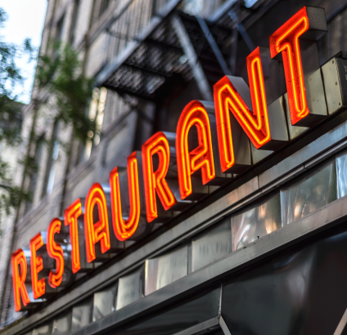
Learning Objectives:
• To associate the brightness of a lamp with the number and voltage of cells used in the circuit
• To use recognised symbols when representing a simple circuit in a diagram
• To design and make a lighting circuit for a restaurant
In this stage, you will build a scaled model of your restaurant and use your electricity learning to design and build a lighting circuit for it.

Slide 3
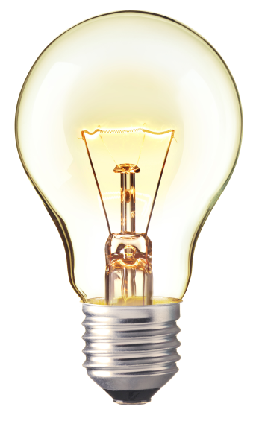
Electricity revision
What is electricity?
How many electrical items can you name?

Slide 4
A lamp/ bulb

Slide 5
A cell/ battery

Slide 6
A wire

Slide 7
A switch

Slide 8
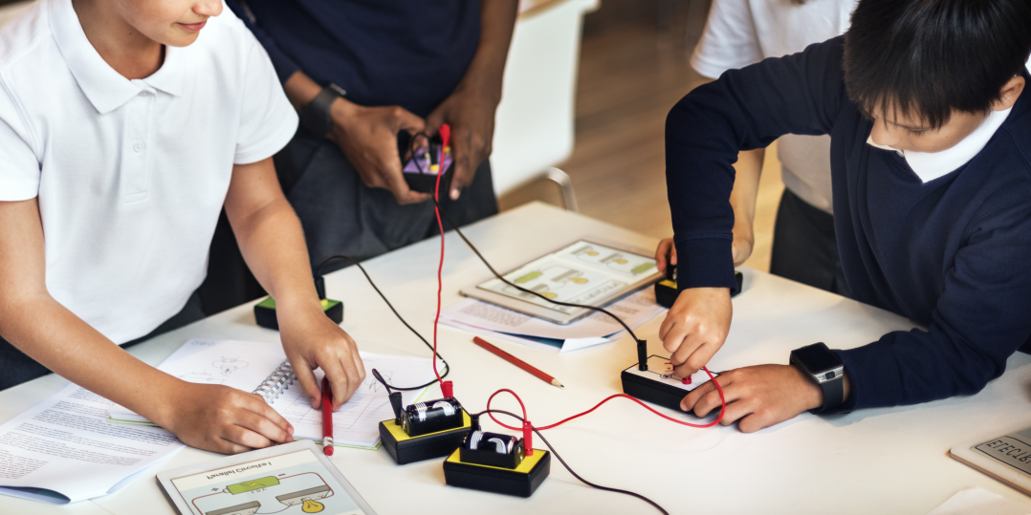
Task 1:
Predict what will happen when:
An additional lamp is added to the circuit
An additional cell is added to the circuit
Test your predictions and use what you know about electricity to explain what you have found.

Slide 9
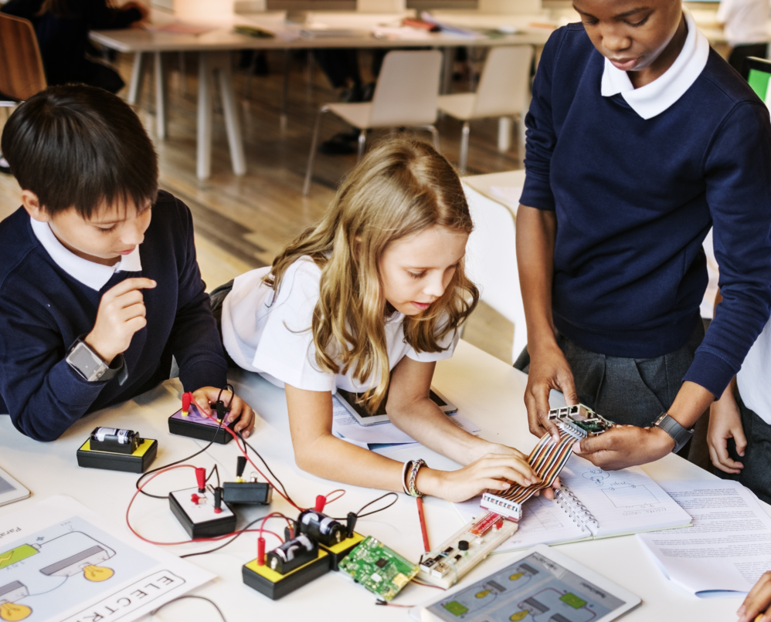
Task 2:
Use the symbols we have learnt to draw a circuit diagram for the lighting in your restaurant.

Slide 10
Volume
What is volume? How do we calculate it?
Volume is the amount of space a 3D shape takes up.
We measure volume in cubic cm or cm³.
You can calculate the volume of a 3D shape by multiplying
height × width × depth

Slide 11
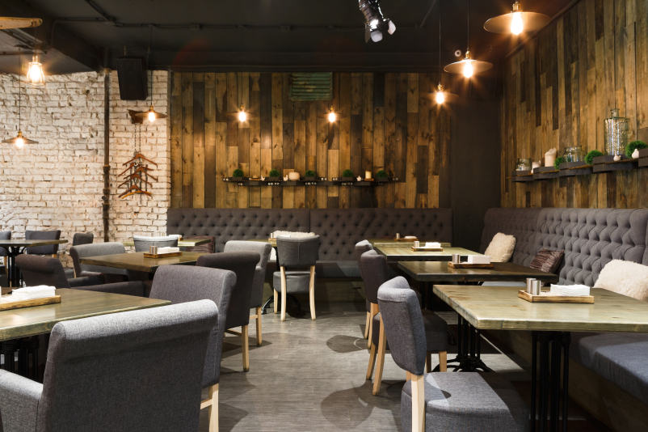
Task 3:
Calculate the total volume of your restaurant from your floor plan. Assume the height of the building is 7m.
Build a 3D model of your restaurant based on your floor plan.

Slide 12
Task 4:
Build a lighting circuit for your restaurant and add it to your model.

